Slide 1

Unlocking insights: House Price Analysis in the Netherlands
Minh Nguyen
Data Analytics bootcamp Ironhack
01/02/2024 – 02/02/2024

Slide 2

Why we need to analyze house price at all?
"Buying a house is a process of elimination until you finally find the one that causes you the least stress and doesn't bankrupt you. It's like dating, but with a mortgage.”
Importance for individuals (buying, selling, invest)
Importance for investors.
Notes:
Thinking about the topic for final project
Many expat friends are buying house, so they asked me for advice as we also bought ours a few years back during covid time
3. There is a quote saying that "Buying a house is a process of elimination until you finally find the one that causes you the least stress and doesn't bankrupt you. It's like dating, but with a mortgage.”
4. So having insights in factors influence house price will be benefit you in your journey of finding your ‘home sweet home’
5. Not only that, it is also important for your real estate investment if you are one (of course)

Slide 3
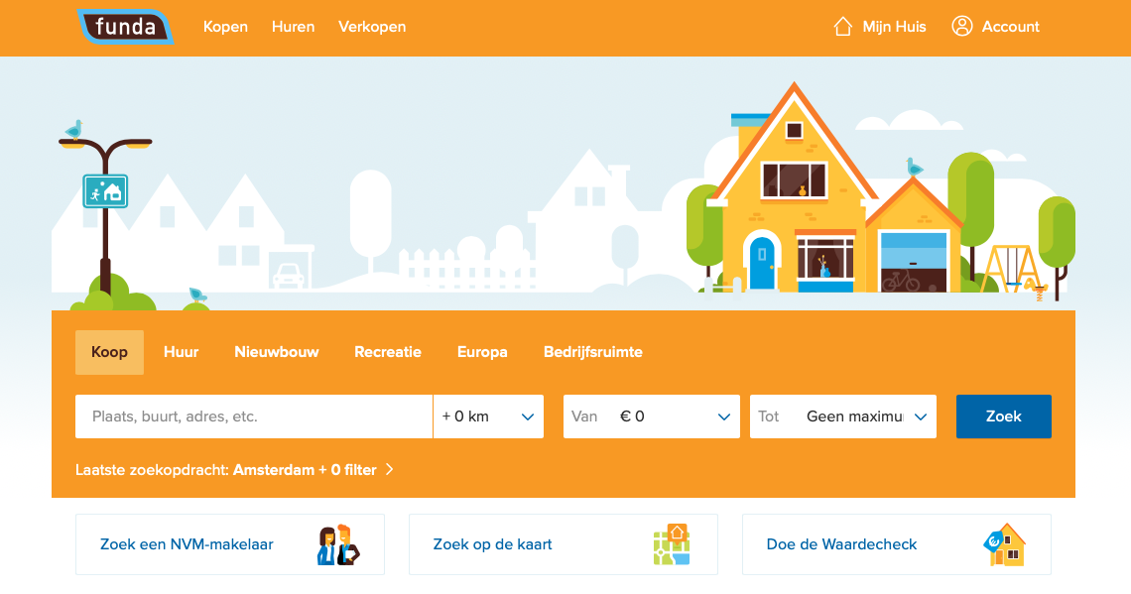
Data collection
Funda-scraper (ref: https://github.com/whchien/funda-scraper)
Notes:
2. Data Collection:
Storytelling with Humor:
Share a brief, light-hearted anecdote about the challenges of collecting real estate data.
Use visuals or memes that represent the process.

Slide 4
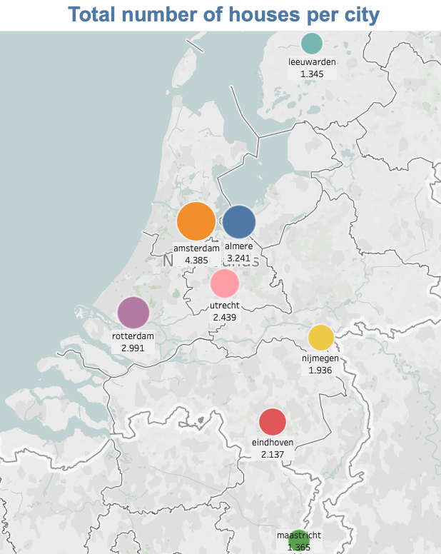
Data collection
Notes:
2. Data Collection:
Storytelling with Humor:
Share a brief, light-hearted anecdote about the challenges of collecting real estate data.
Use visuals or memes that represent the process.

Slide 5
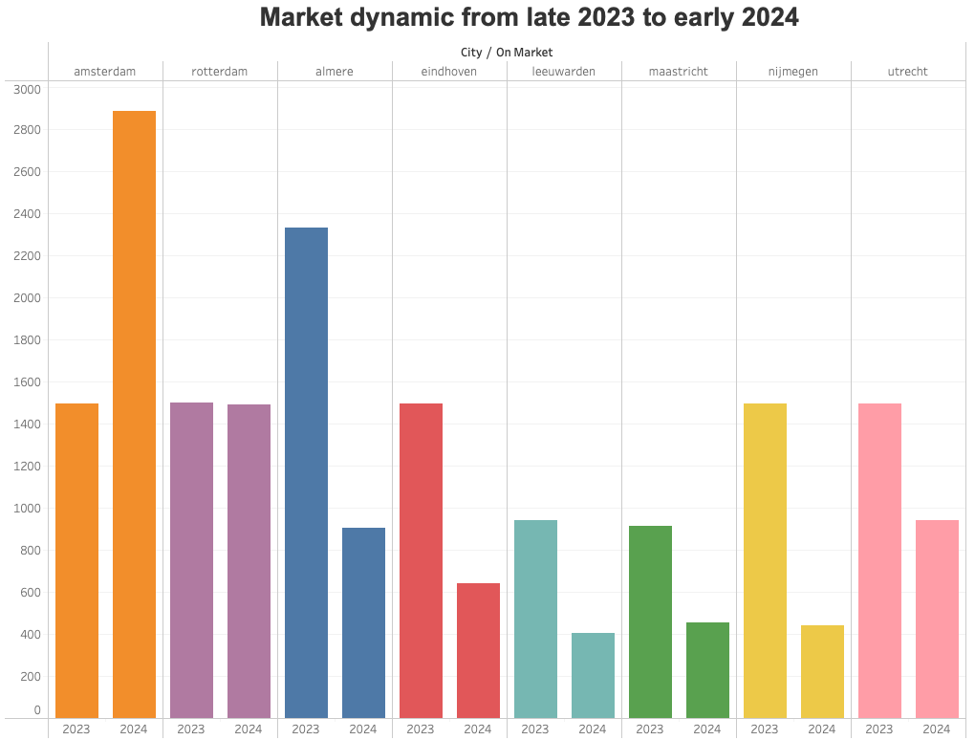
Data collection
Notes:
2. Data Collection:
Storytelling with Humor:
Share a brief, light-hearted anecdote about the challenges of collecting real estate data.
Use visuals or memes that represent the process.

Slide 6
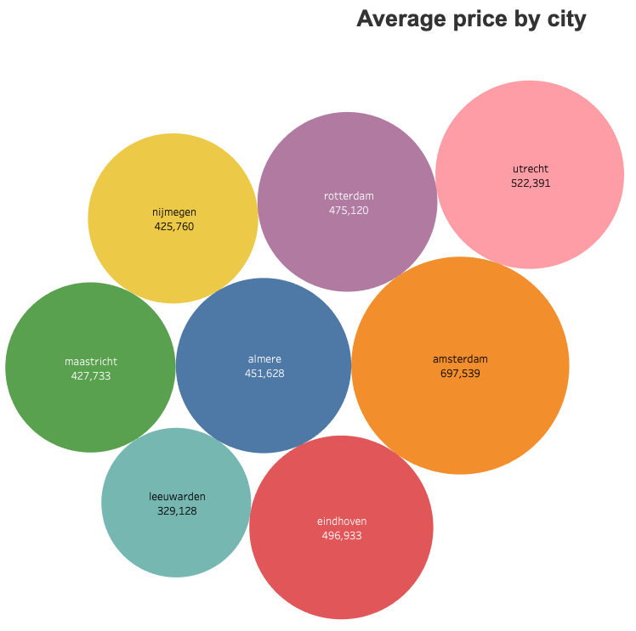
How does house market look across cities?
Notes:
Showcase a few interesting findings from your EDA.
Use visualizations (charts, graphs) to convey insights.
Emphasize any patterns, correlations, or anomalies you discovered.

Slide 7
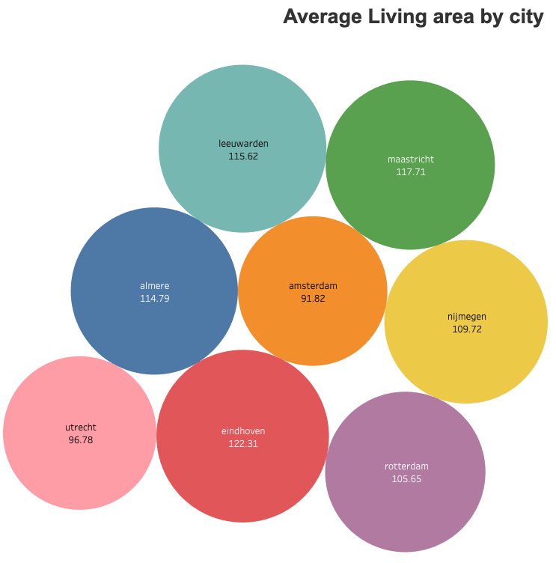
How does house market look across cities?
Notes:
Showcase a few interesting findings from your EDA.
Use visualizations (charts, graphs) to convey insights.
Emphasize any patterns, correlations, or anomalies you discovered.

Slide 8
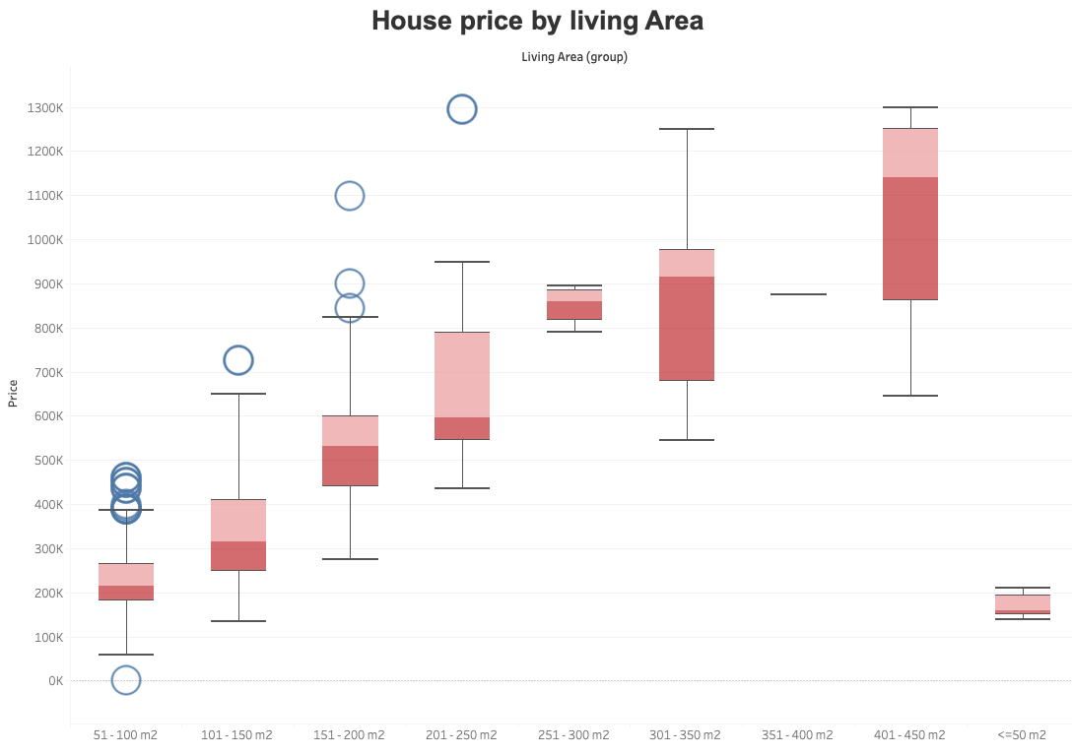
What influences the house price?
Notes:
Showcase a few interesting findings from your EDA.
Use visualizations (charts, graphs) to convey insights.
Emphasize any patterns, correlations, or anomalies you discovered.

Slide 9
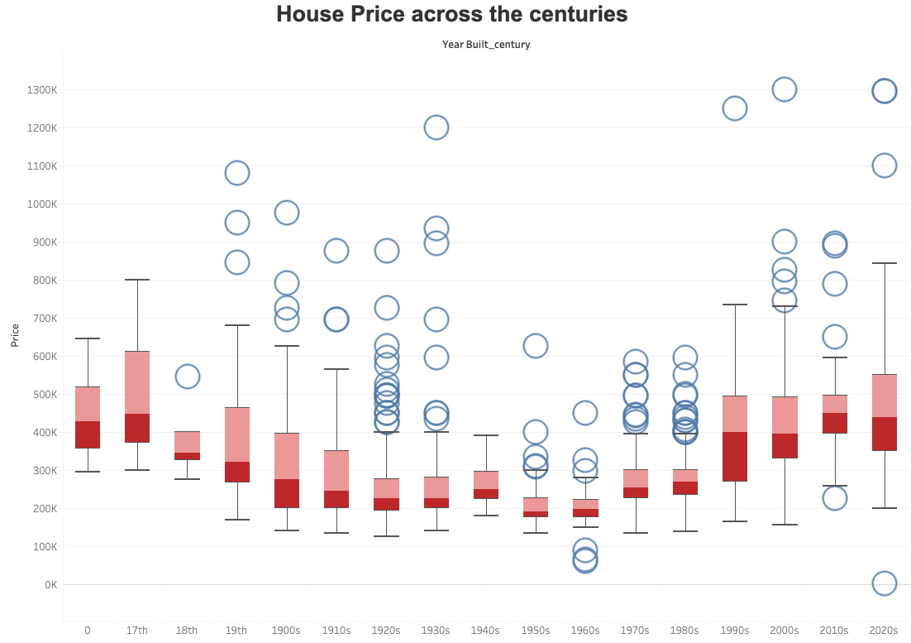
What influences the house price?
Notes:
Showcase a few interesting findings from your EDA.
Use visualizations (charts, graphs) to convey insights.
Emphasize any patterns, correlations, or anomalies you discovered.

Slide 10
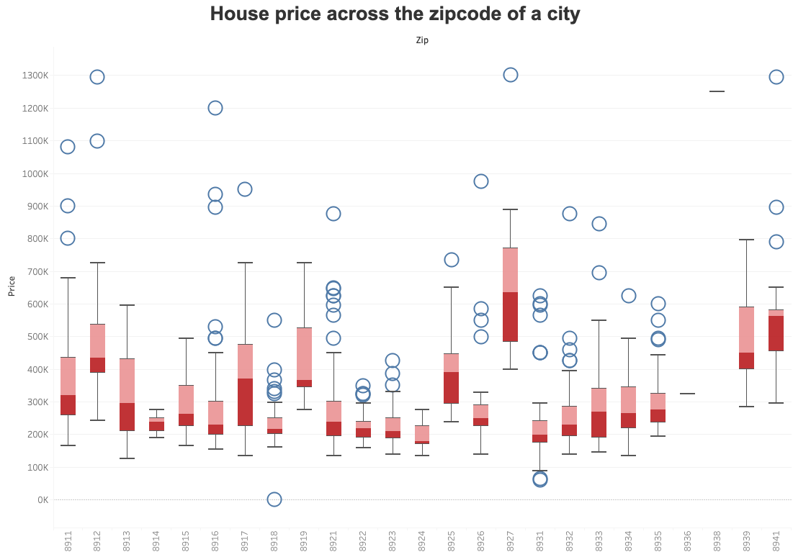
What influences the house price?
Notes:
Showcase a few interesting findings from your EDA.
Use visualizations (charts, graphs) to convey insights.
Emphasize any patterns, correlations, or anomalies you discovered.

Slide 11
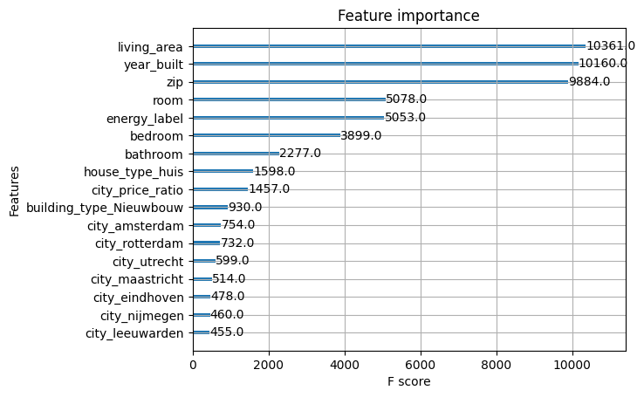
Features influence house price
Notes:
4. Feature Engineering:
Engage the Audience:
Ask the audience to guess which features they think have the most impact on house prices.
Share interesting correlations with a touch of humor.

Slide 12
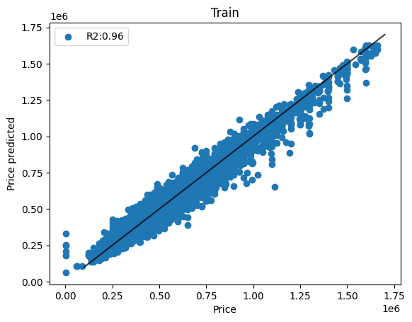
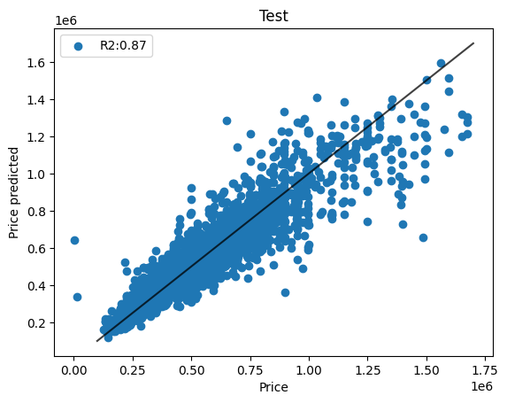
ML model
linear regression -> KNN -> random forest -> XGBoost
Combine data (8 cities):
Heterogenous dataset
Correct for city price factor
single city data:
Small dataset
Local overview

Slide 13
discussion
limitations:
The price is a listing price, and not the actual selling price → cannot correct for that
Static dataset in a short timeframe (late 2023 – early 2024)
to have a better picture of house price market prediction:
price over years in combination with interest rate, inflation, economics recession…
the scarcity of the interested house market (demand vs supply)
Notes:
. Future Work and Conclusion:
Interactive Poll for Future Work:
Ask the audience what aspects they find most interesting and would like to explore further.
This could lead to a lively discussion.

Slide 14

Thank you!
Notes:
. Future Work and Conclusion:
Interactive Poll for Future Work:
Ask the audience what aspects they find most interesting and would like to explore further.
This could lead to a lively discussion.

Slide 15
Housing Institutions & Governance
Housing is a key topic in urban development and welfare. Housing and in particular affordable housing is an urgent issue across the globe. For new housing solutions research is necessary, in particular comparative research, since countries can learn much from each other.
Housing Market Dynamics
Housing market analyses aims to unravel the functioning of the housing market by focussing on demand, supply and price and their interdependence. In order to identify structural changes, both quantitative modelling orientated research as qualitative research is conducted, taking into account the role of different tenures, government policies and the role of financial institutions on the housing market.
Housing is of key importance for societies. It drives the economy; is a key for social inclusion and a key issue for urban and regional development in growing as well as declining areas. The global financial crisis had a huge impact on housing markets and with that on the economy, social inclusion and urban and regional development. Housing systems are substantially changing.

Slide 16
Ams , north holland
Almere, flevoland
Rotterdam , south holland
Utrecht, utretch
Nijmegen, gelderland
Eindhoven, north brabant
Leeuwarden, frisland
Maastricht, limburg
https://en.wikipedia.org/wiki/Provinces_of_the_Netherlands

Slide 17
Discussion – Future perspectives - improvements
wants to identify promising areas for real estate investment in Europe by building a predictive tool for location growth, using factors such as economic drivers, livability, connectivity, and demographics
Incorporate interest rate for new mortgage in Netherlands

